Slide 1

Solution 4: Message GUI

Slide 2
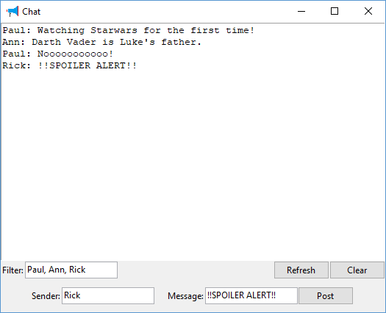
Solution 4: Message GUI
Message Board
Notes:
Not too ruff
Won’t hurt my felines.
Getters and Setters (not the Irish kind)
No need to Pause between them

